Slide 1

Workload Forecast System
Alexey Kozarnikov
Mariia Fedotenkova
Galina Lavrentyeva
LUT 2012

Slide 2
Roles
Consultant can view and edit his forecasts. He can also add new projects and clients to the database
Manager can do the same, but he can view the data of every consultant
Controller can view the forecast of consultant and comment them
Resourcing representative can view the forecasts
Director can view forecasts and summaries
Administrator manages user’s data

Slide 3
The structure of the project
The whole project is divided into several pages:
Personal cabinets of consultant, manager, resource representative, controller, director
Authorization page
Administration page

Slide 4
Technologies in use
Grails framework
open source web application framework which uses the Groovy programming language, which is based on the Java platform.
MySql database
  Open-source database
  Easy to maintenance
  Cross-platform

Slide 5
Sprint 1
Understanding client needs
Collecting and analyzing requirements
Project design
DataBase realization
Basic functional
Web-pages design
Testing

Slide 6
Sprint 2
HTML pages
Full functionality
Testing

Slide 7
Sprint 3
Working on some advanced features
Testing
Bug fixing

Slide 8
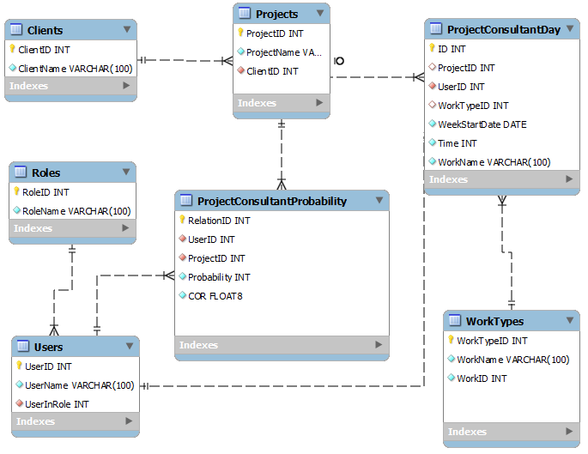
Database structure

Slide 9
Authorization page
Introduction
User login fields
Obtaining user information
User role identification

Slide 10
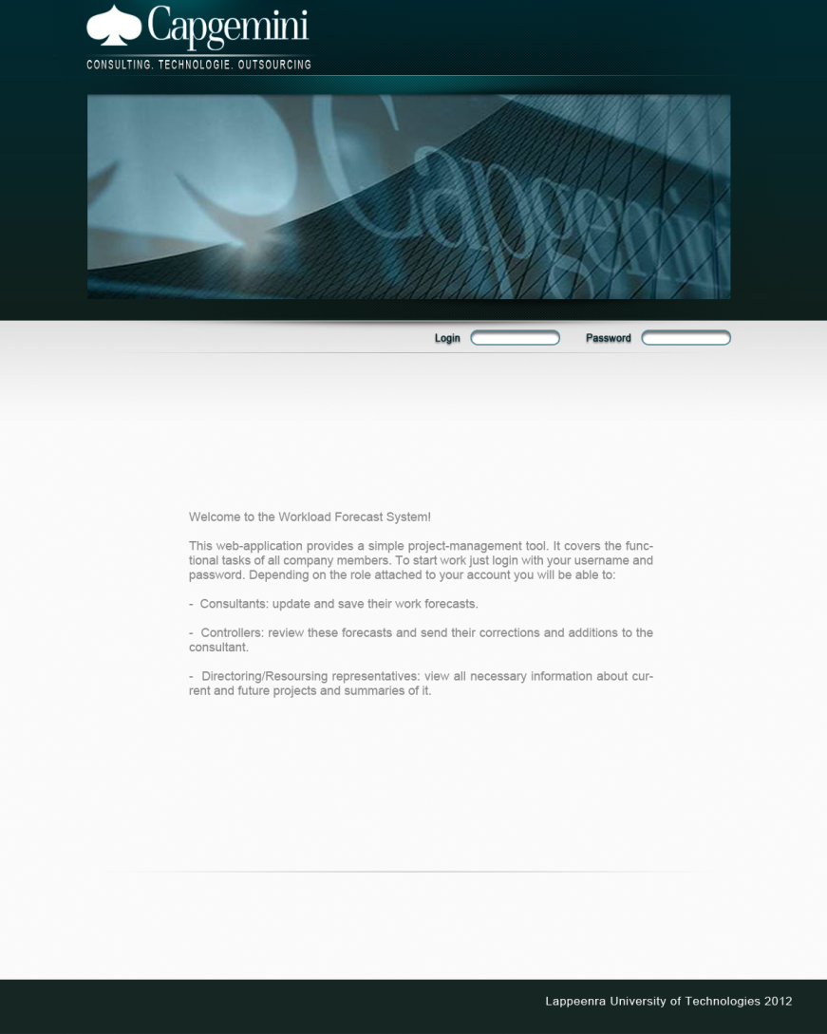

Slide 11
Consultant’s page features
View/edit personal forecast
View messages from controller
Create/delete clients and projects

Slide 12
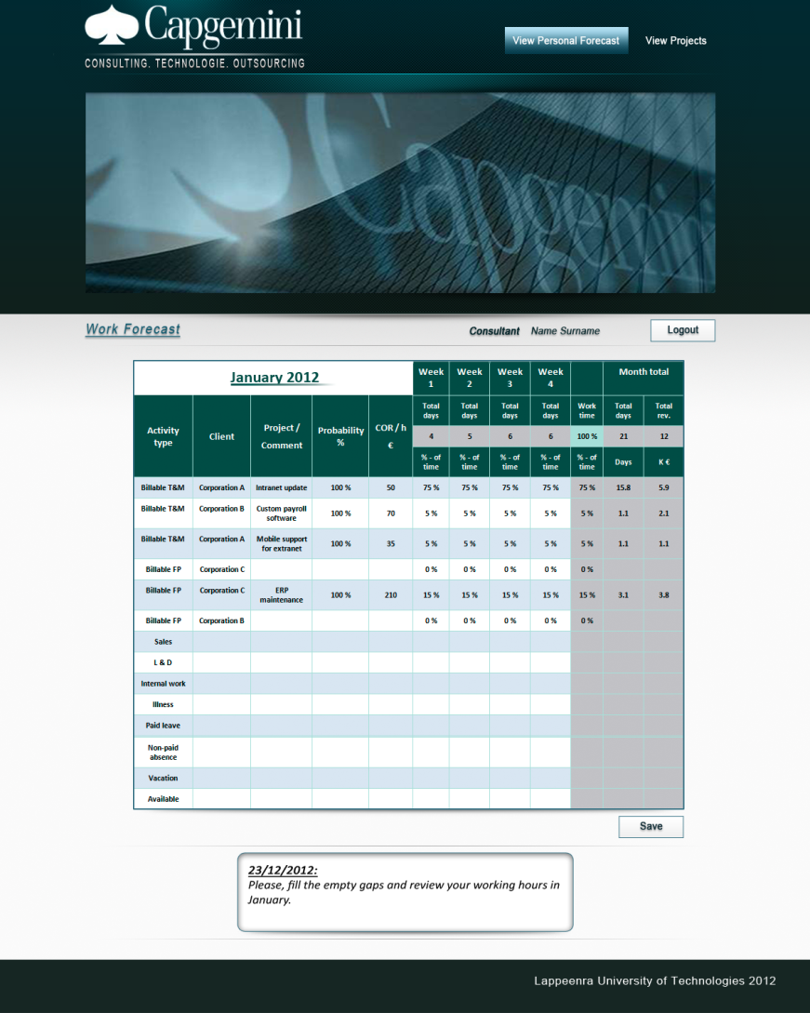

Slide 13
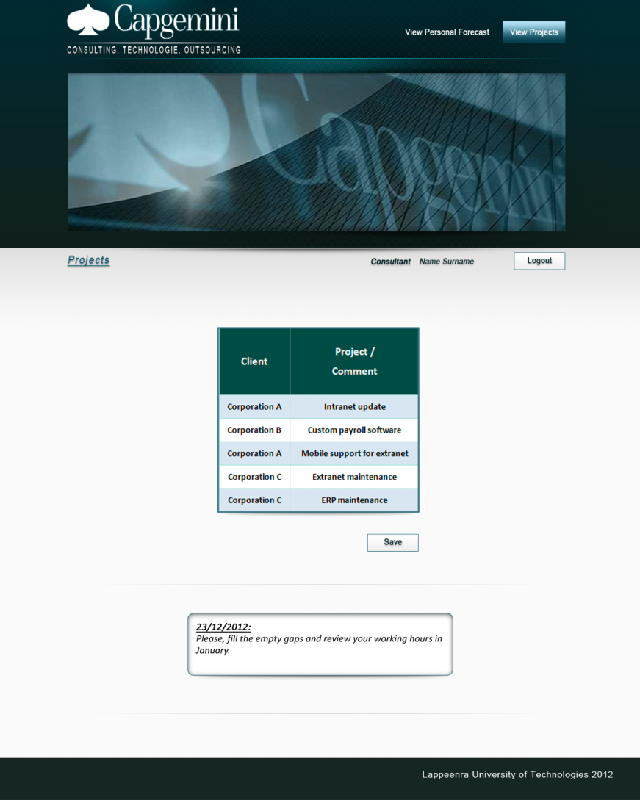

Slide 14
Controller’s page features
View personal forecast of every consultant
Send messages to the consultants

Slide 15
Manager’s page features
View and edit personal forecast of any consultant
Add/delete clients and projects

Slide 16
Resourcing representative’s page
Viewing the forecasts of any consultant
View summaries from forecasts

Slide 17
Director’s page
View forecasts of consultants
View special summaries from forecasts

Slide 18
Administrator’s page
Add/delete user
User login and password changing

Slide 19
Future steps
Pages interface for all roles
Help for all roles (Tooltip message)
AJAX (Asynchronous JavaScript and XML)
Dynamic update in tables
Message page for consultant
Report system

